Slide 1

AMERICAN INTERNATIONAL UNIVERSITY BANGLADESH
Section-H
Alert Level: Investigating and Preventing Food Contamination Problem in Bangladesh using AI
NAME | ID | Department
Sharfin Ahmed Shanto | 22-49561-3 | CSE
Khushbu Alam Rahi | 22-46947-1 | CSE
Sadikuzzaman Rakib | 22-46971-1 | CSE
MD Eaoumoon Haque | 22-47526-2 | CSE

Slide 2

Introduction
Food Contamination Challenge
• Millions affected yearly: 11,000+ confirmed foodborne infections in the US in 2013 [1].
• Harmful agents: Bacteria, viruses, parasites threaten food safety during production [2].
• Need for innovation: Traditional methods have limitations; new solutions required

Slide 3

Tech Solutions for Food Safety
Blockchain traceability: Track food journey, identify contamination points.
• Smart sensors: Monitor critical factors for food safety.
• AI prediction: Analyze data, predict outbreaks, take preventive measures.

Slide 4
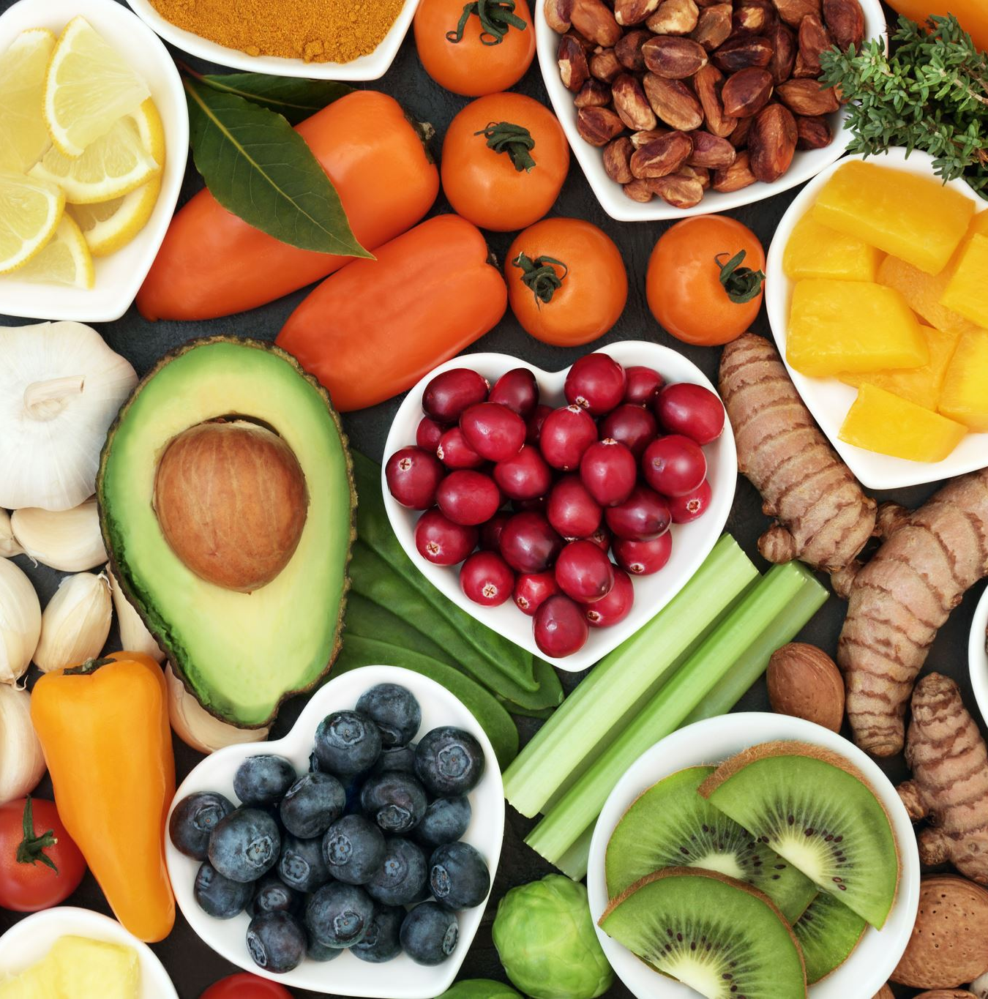
Benefits of a Safer Food System
• Healthier population: Reduced foodborne illnesses.
• Sustainable food security: Ensure safe food for 10 billion people by 2050.
• Better future: Innovative food safety for a healthier, more sustainable world

Slide 5
METHODOLOGY

Slide 6

Objective of the Survey:
Explore students' awareness of contaminated food in Bangladesh.
Scope of the Survey:
Knowledge about contaminated food.
Extent of consumption.
Sources of contaminated food.

Slide 7

Data Collection Method:
Utilized Google Forms for a questionnaire with 15 questions.
Combination of single-choice and multiple-choice formats.
Privacy Considerations:
No personal information was collected during the survey.

Slide 8

RESULTS

Slide 9
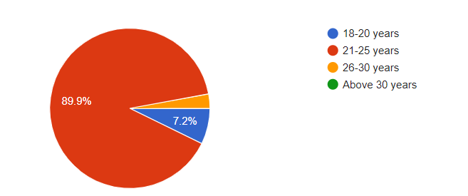
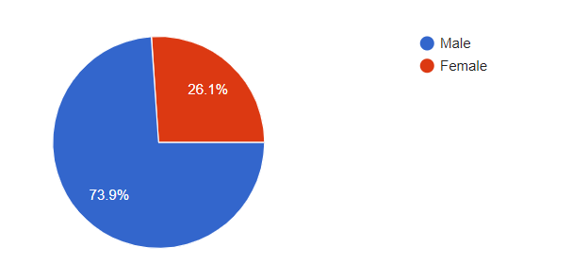
Pie Chart of Participant Ages
Pie Chart of Participant Gender
Age Distribution
Key Age Groups
Age-Related Trends
Gender Distribution
Key Gender Categories
Significant Male Representation

Slide 10
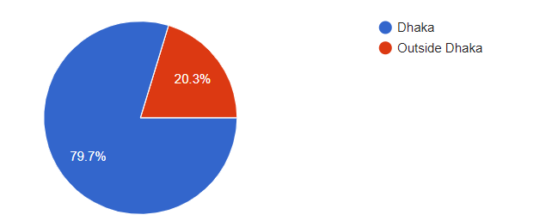
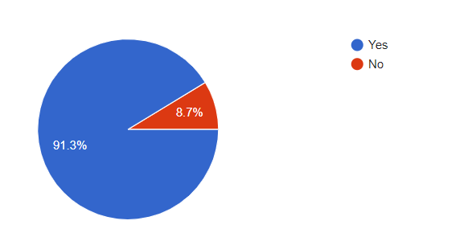
Geographic Distribution of Participants
Participants' Awareness of Food Contamination
Regional Distribution
Key Regions
Majority Residency Percentage
High Awareness Level
Minority Unaware
Importance of Awareness

Slide 11
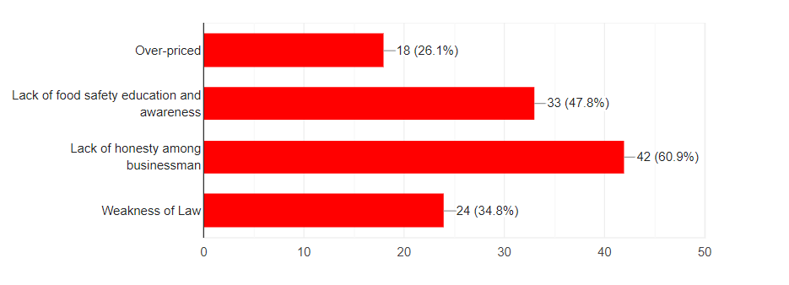
Factors in Food Contamination: Analysis
Public Perception
Individual Factors

Slide 12
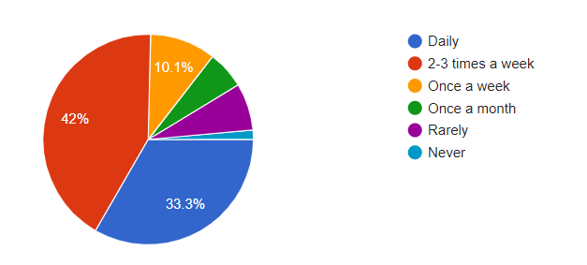
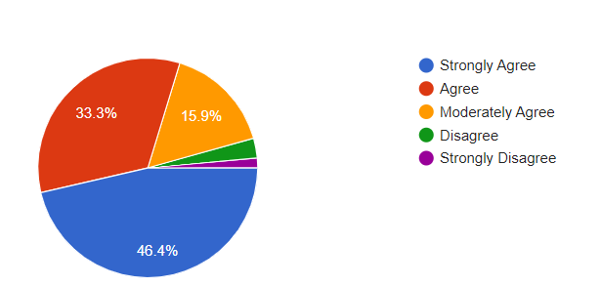
Consumer Purchases: Processed Food Frequency
Market Food Perception: Contamination Views
Dominant Reliance
Frequent Purchases
Dominant Agreement
Minority Disagreement

Slide 13
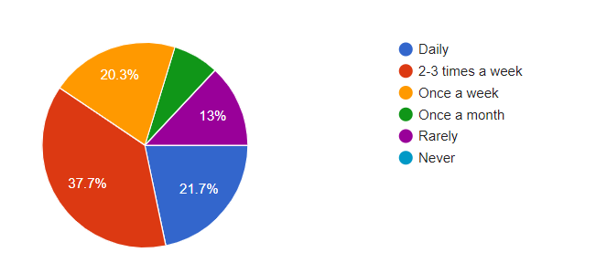
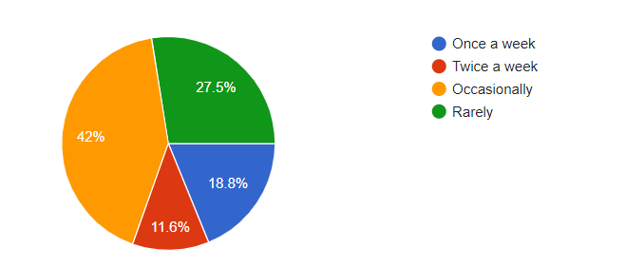
Dining Habits: Outside Food Frequency
Health Impact: Discomfort from Outside Food
Prevalence of discomfort
Inconsistency
Potential causes
High reliance on outside food
Regular indulgence

Slide 14
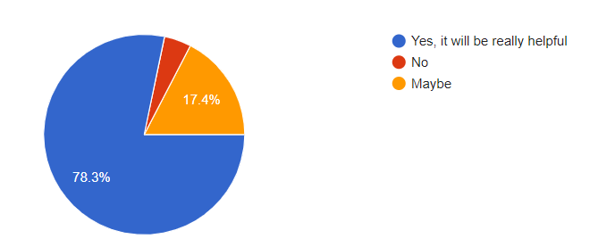
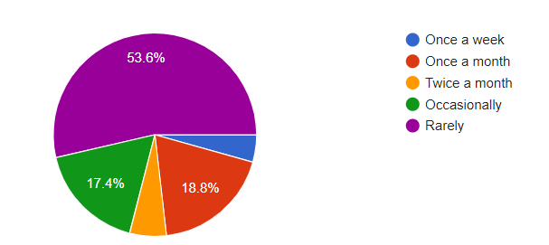
Healthcare Trends: Doctor Visits for Food Poisoning
Tech Appetite: Food Contamination App Interest
Willingness to Use Food Contamination Detection App
Visual Representation
Self-management tendency
Varying perspectives

Slide 15
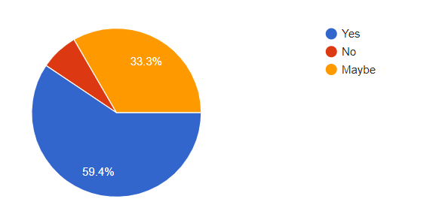
Perception Understanding: Impact on Threat Reduction
Affirmative Response
Diverse Perspectives

Slide 16
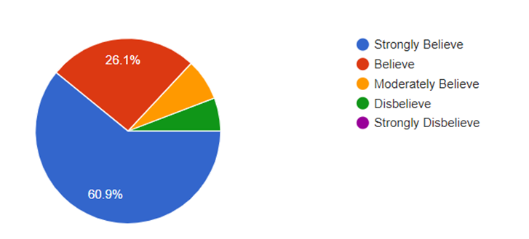
Safety Advocacy: Stricter Food Regulations
Clear Demand for Change
Minimal Opposition

Slide 17

Recomendation
Machine Learning(ML) in AI.
Current apps doing same thing(YUKA).
Effectiveness of current apps.

Slide 18
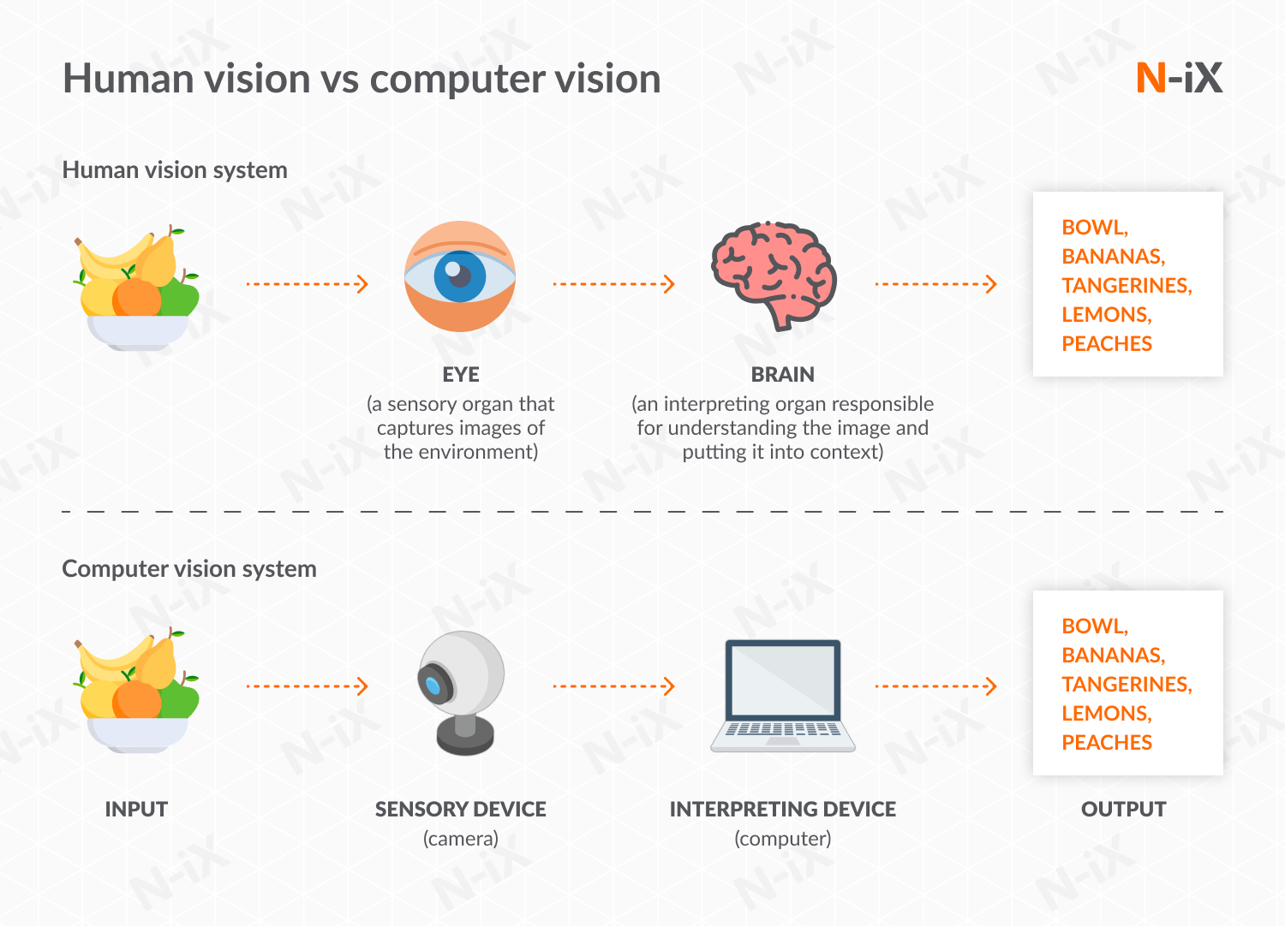
Recomendation
Previous Research.
Computer Vision System(CVS).
Smartphone detection possibility.

Slide 19
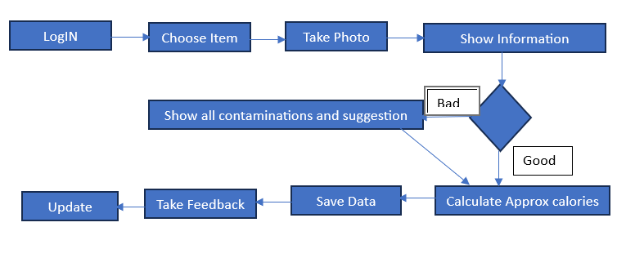
Recomendation
Introducing Foodie as a solution.
Working process “simple but effective”
Behind mechanism.

Slide 20

Recomendation
Limitations.
Future plan.
Ensuring better future.

Slide 21

Conclusion
Relevance of Food Safety
Use of AI as solution.
Opportunities for food safety app.
Ensuring safe food.

Slide 22
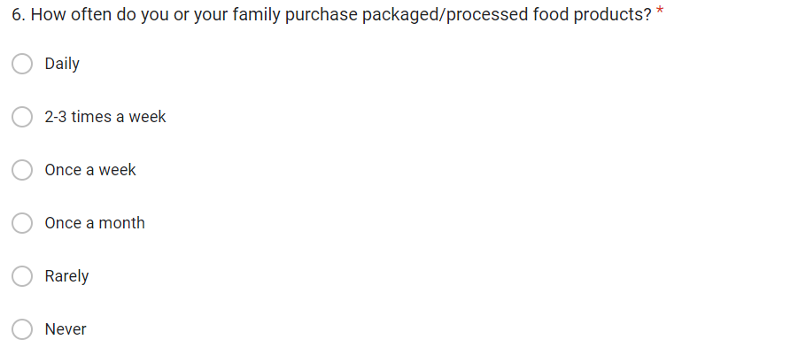
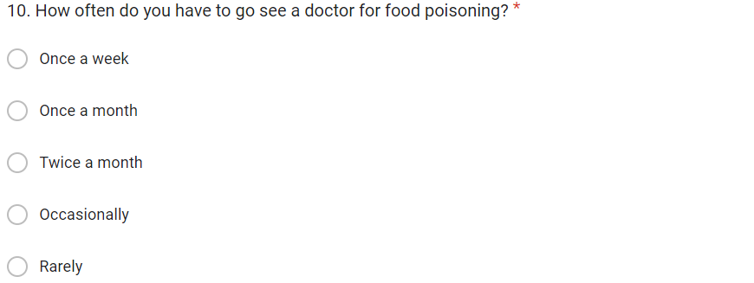


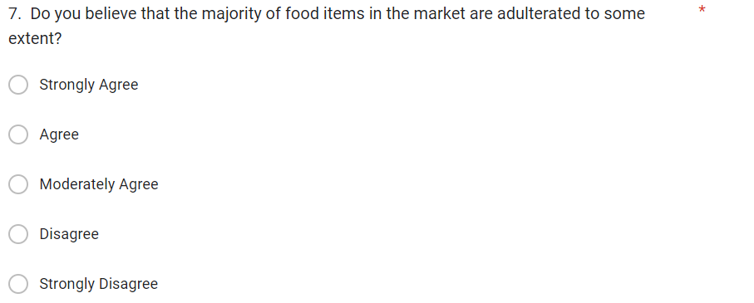


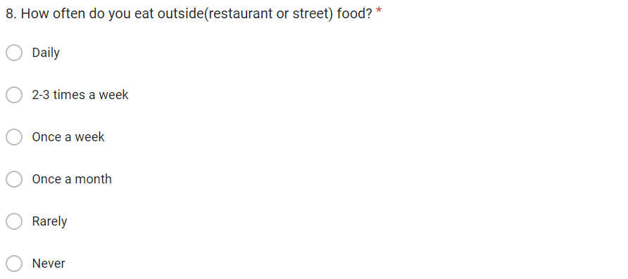
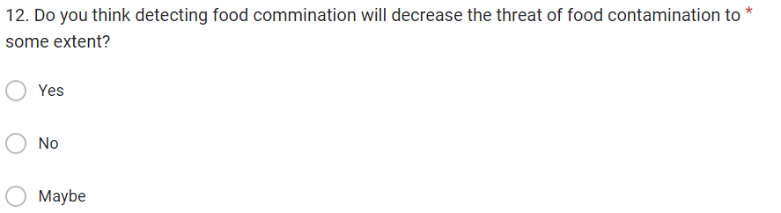
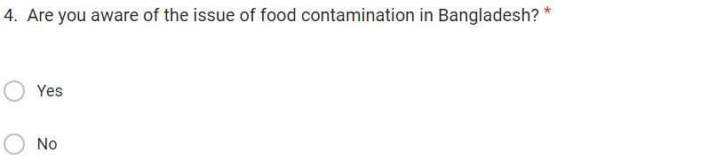
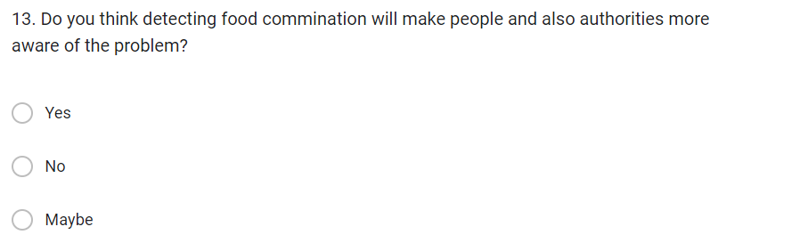
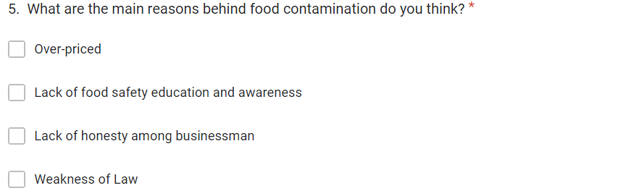

APPENDIX :

